Slide 1
Open Mindness
presented by
P. VINAY KUMAR
209F1A0596
3 RD YEAR CSE-2

Slide 2
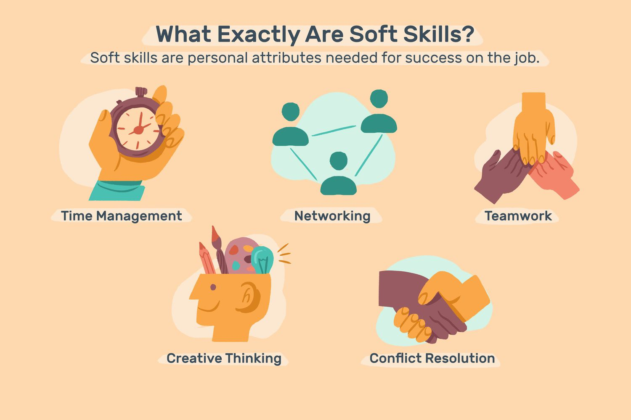

Slide 3
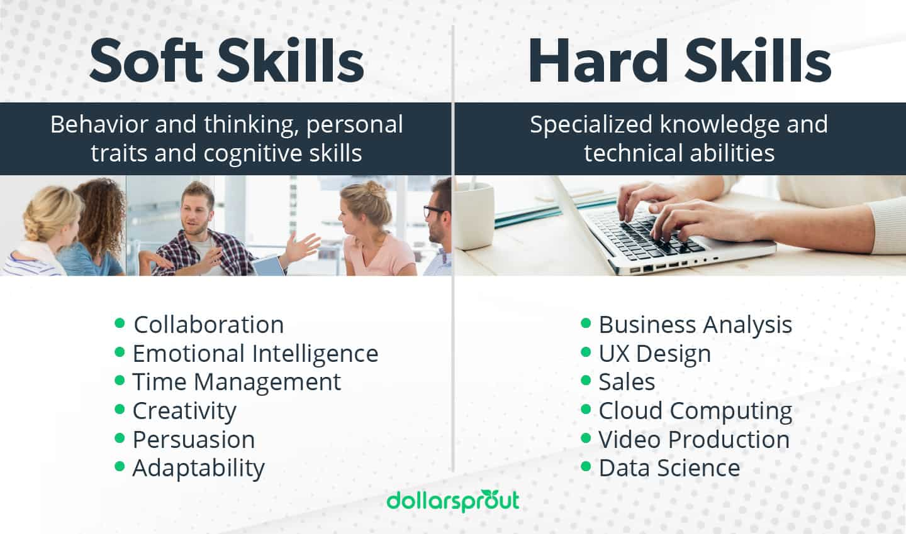

Slide 4
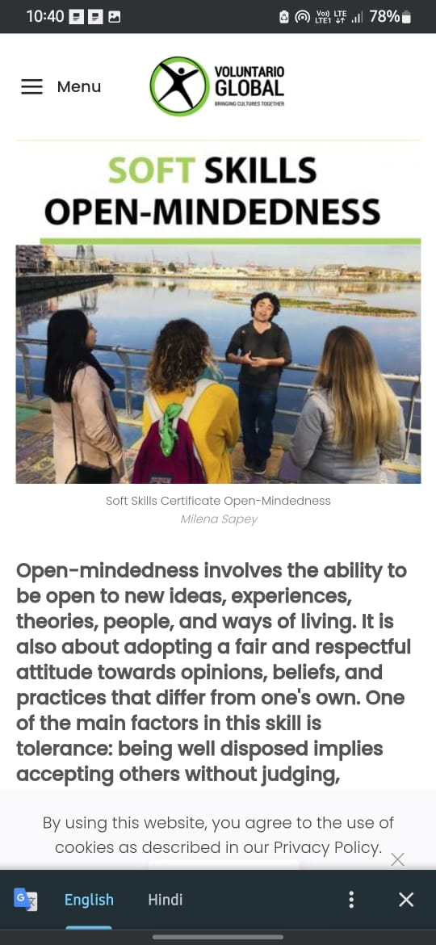
-- Being open mindness easy to moving to others,easy to communicate work places or relationships.

Slide 5


Slide 6
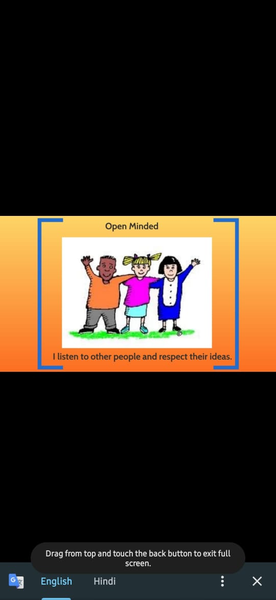

Slide 7
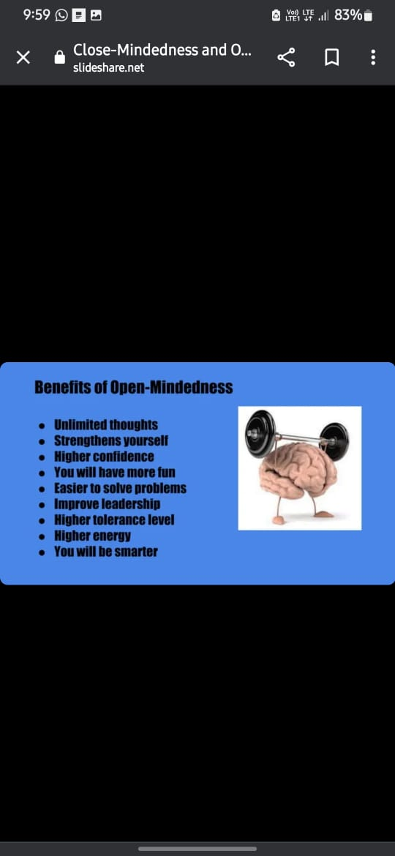

Slide 8

Characteristics of open midness
Be curious to hear what others think
Be able to have their ideas challenged
Not feel angry when they are wrong
Have empathy for other people
Consider what other people are thinking

Slide 9
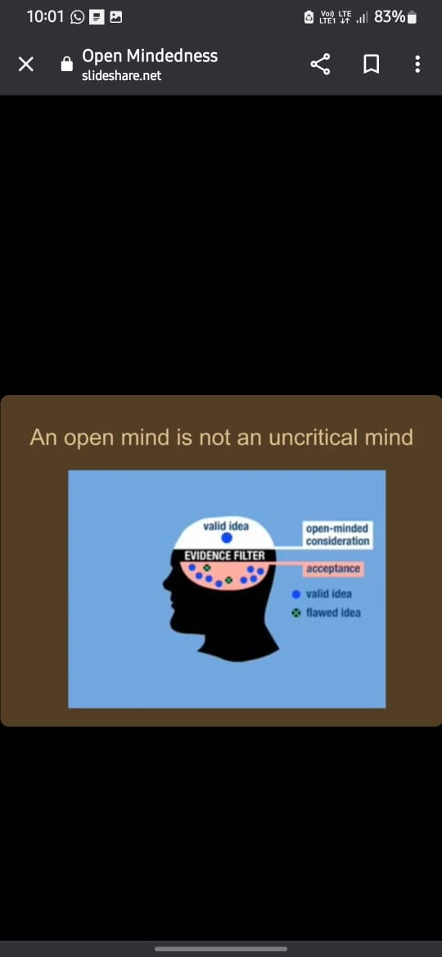

Slide 10
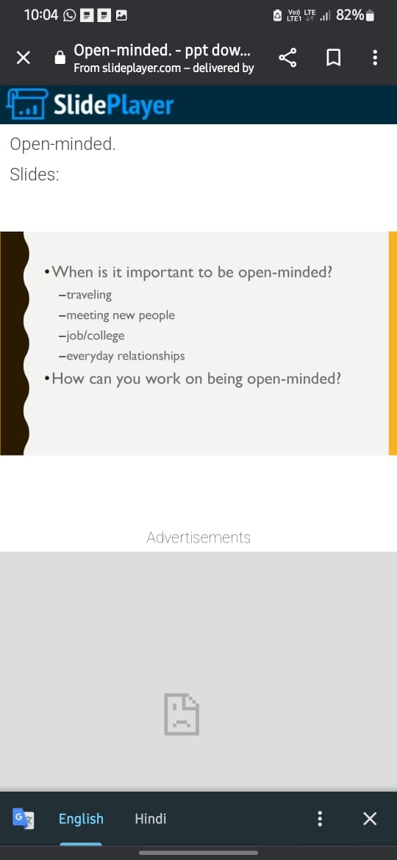

Slide 11


Slide 12
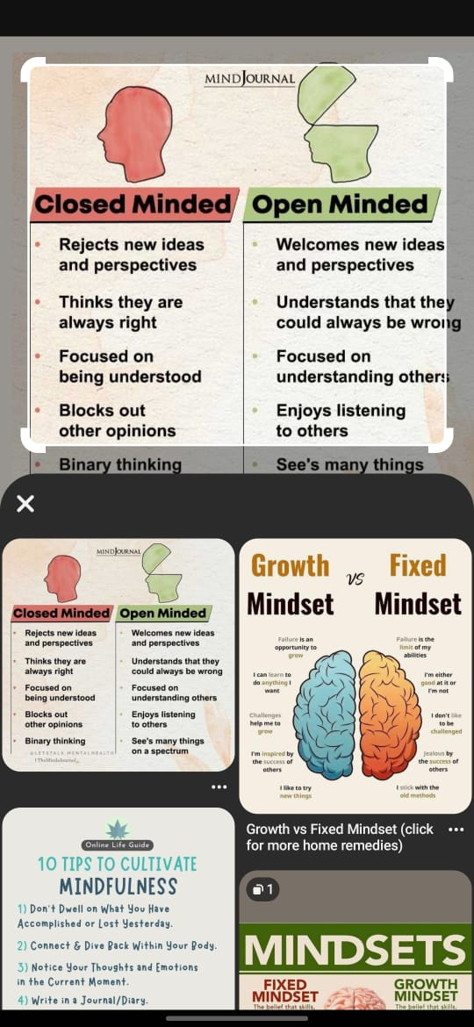

Slide 13


Slide 14


